Slide 1
Chapter 3
Digital Signature

Slide 2
COMPARISON
Differences between conventional signatures and digital signatures.
Inclusion
Verification Method
Relationship
Duplicity

Slide 3
1. Inclusion
A conventional signature:
included in the document; it is part of the document.
Digital signature:
The signature as a separate document.
Sender send two document:-
Message
Digital signature

Slide 4
2. Verification Method
conventional signature:
Receiver compares the signature on the document with
the signature on file.
digital signature:
Copy is not stored anywhere.
receiver receives the message and the signature and
apply a verification technique to the combination of the message and the signature to verify the authenticity.

Slide 5
3. Relationship
Conventional signature:
one-to-many relationship between a signature and documents.
one person uses same signature on many documents.
digital signature:
one-to-one relationship between a signature and a message.
Most of the time each message needs new signature.

Slide 6
4. Duplicity
conventional signature:
a copy of the signed document can be distinguished from the original one on file.
digital signature:
there is no such distinction unless there is timestamp on the document.
For example: Alice sends a document instructing Bob to pay Eve. If Eve intercepts a document and signature, she can replay it later to get money again from Bob.

Slide 7
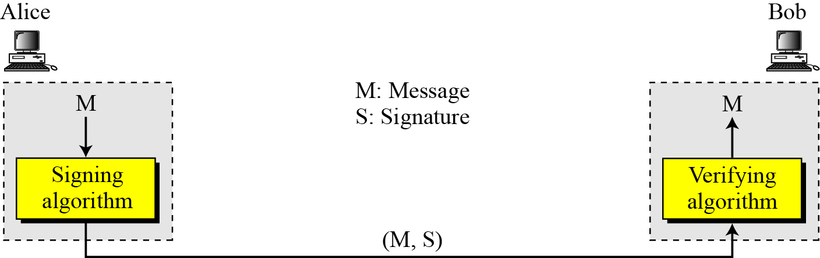
PROCESS
Digital signature process
Sender uses a signing algorithm to sign the message.
Message and the signature are sent to the receiver.
Receiver receives both and the signature and applies the verifying algorithm to the combination.
If the result is true, the message is accepted; otherwise, it is rejected.

Slide 8
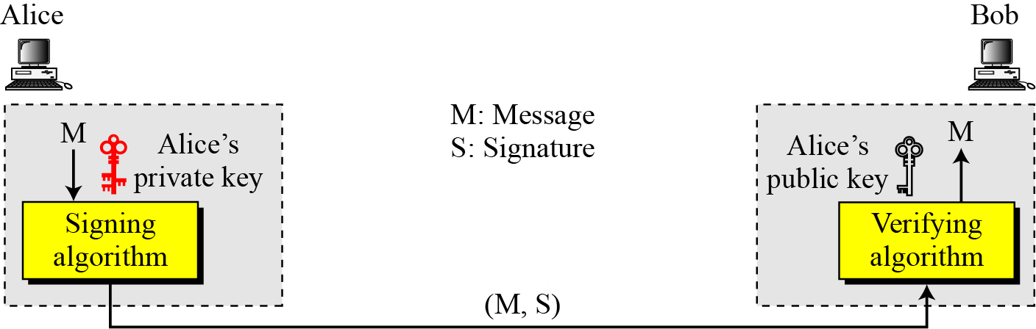
Need for Keys
Adding key to the digital signature process
A digital signature needs a public-key system.
The signer signs with her private key; the verifier verifies with the signer’s public key.

Slide 9
SERVICES
Digital Signature provides following services:
Message Authentication
Message Integrity
Nonrepudiation
Confidentiality

Slide 10
1. Message Authentication
Data origin authentication
Bob can verify that message has come from Alice
because Alice’s public key is used for verification.
Alice’s public can not verify signature signed by any
other’s private key.
A digital signature provides message authentication.

Slide 11
2. Message Integrity
We cannot get the same signature if the message is changed.
A digital signature provides message integrity.

Slide 12
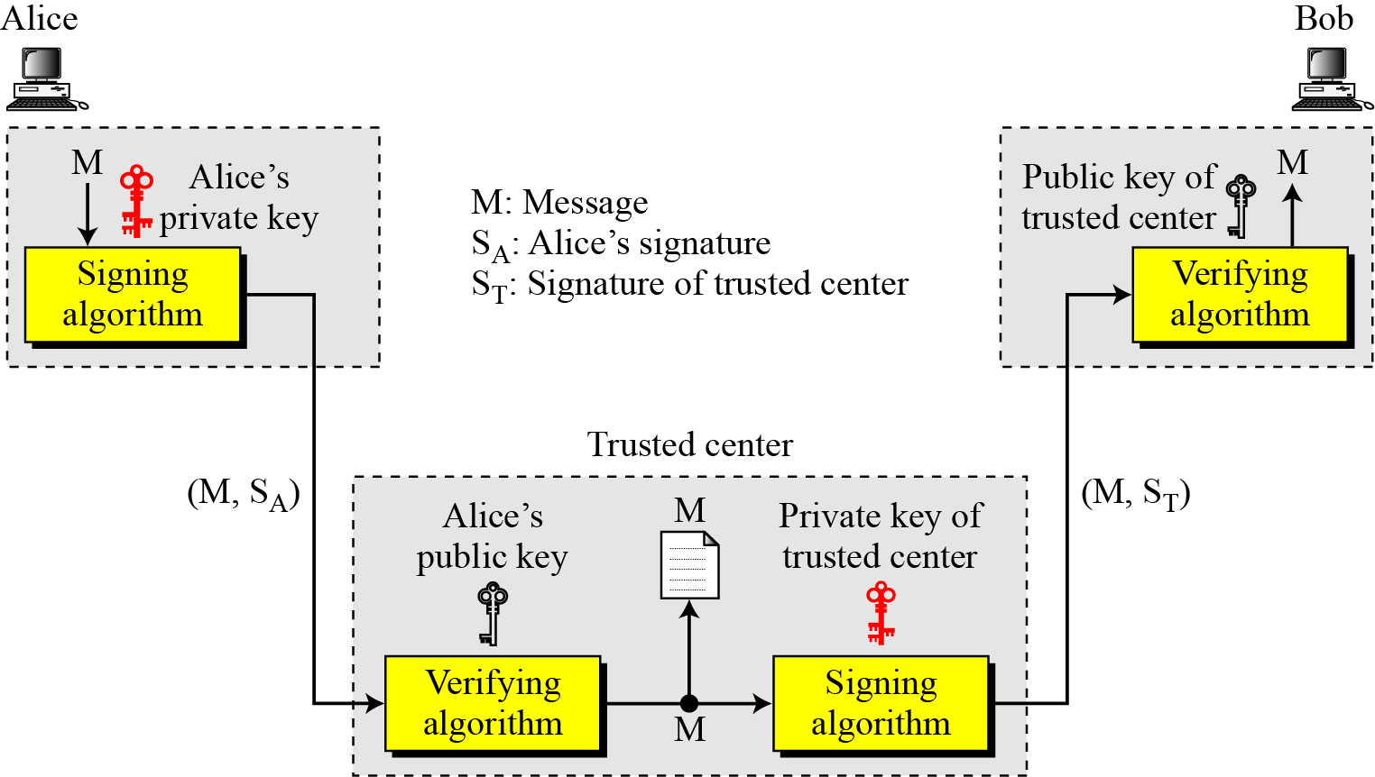
3. Nonrepudiation
Using a trusted center for nonrepudiation
Nonrepudiation can be provided using a trusted party.

Slide 13
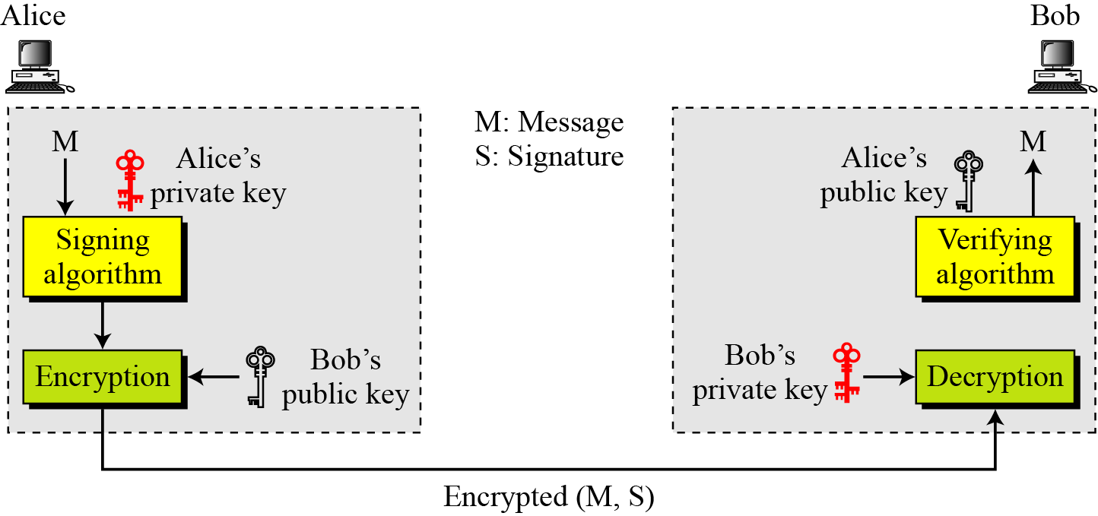
4. Confidentiality
Adding confidentiality to a digital signature scheme
A digital signature does not provide privacy.
If there is a need for privacy, another layer of encryption/decryption must be applied.

Slide 14
ATTACKS ON DIGITAL SIGNATURE
Attack Types
Key-Only Attack
Known-Message Attack
Chosen-Message Attack
Forgery Types
Existential Forgery
Selective Forgery

Slide 15
Attack Types
Key-Only Attack
Attacker knows only public key released by Alice.
To forge message, attacker needs to create Alice’s signature.
Known-Message Attack
Attacker has some documents previously signed by
Alice.
Attacker tries to create another message and forge Alice’s signature on it.

Slide 16
Attack Types
Chosen-Message Attack
Attacker somehow makes Alice sign one or more messages for him.
Attacker now has chosen-message /signature pair.
Attacker later creates another message, and forge Alice’s signature on it.

Slide 17
Forgery Types
Existential Forgery
Document is forged, but the content is randomly calculated; unfortunately the document is syntactically or semantically unintelligible.
Attacker can not get benefit from it.

Slide 18
Forgery Types
Selective Forgery
Attacker may be able to forge Alice’s signature on a
message with the content selectively chosen by him.
This is beneficial to attacker but may be very
detrimental to Alice.
The probability of such forgery is low , but not negligible.

Slide 19
DIGITAL SIGNATURE SCHEMES
A digital signature scheme is a mathematical scheme for demonstrating the authenticity of a digital message or document.
A digital signature scheme typically consists of three algorithms:
A key generation algorithm that selects a private key uniformly at random from a set of possible private keys. The algorithm outputs the private key and a corresponding public key.
A signing algorithm that, given a message and a private key, produces a signature.
A signature verifying algorithm that, given a message, public key and a signature, either accepts or rejects the message's claim to authenticity.

Slide 20
DIGITAL SIGNATURE SCHEMES
RSA Digital Signature Scheme
ElGamal Digital Signature Scheme
Schnorr Digital Signature Scheme
Digital Signature Standard (DSS)

Slide 21
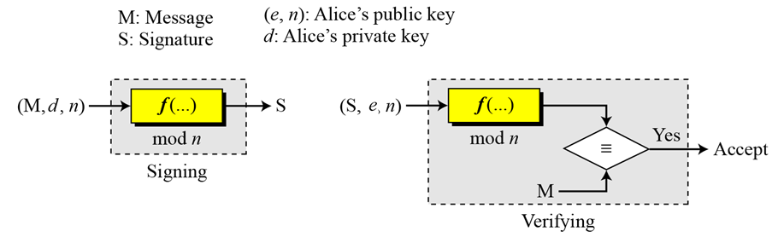
1. RSA Digital Signature Scheme
General idea behind the RSA digital signature scheme

Slide 22
1. RSA Digital Signature Scheme
Key Generation
Key generation is exactly the same as key generation in the RSA
Alice chooses 2 prime numbers p and q and calculates n = p*q
Alice calculates Ф(n) =(p-1)(q-1)
She then chooses e, the public exponent, and calculates d, the
private exponent such that e*d = 1 mod Ф(n)
Alice keeps d and publicly announces e and n
In the RSA digital signature scheme, d is private; e and n are public.

Slide 23
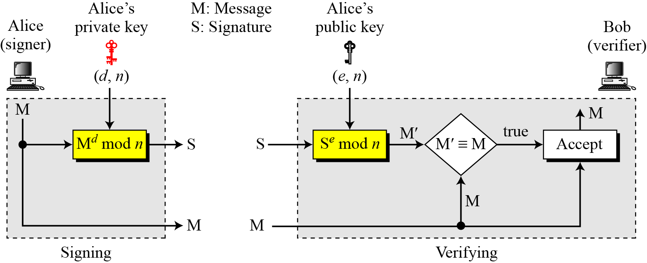
1. RSA Digital Signature Scheme
Signing and Verifying
RSA digital signature scheme

Slide 24
1. RSA Digital Signature Scheme
Example
Alice chooses p = 823 and q = 953, and calculates n = 784319.
φ(n)=782544.
Suppose Alice chooses e = 313 and calculates d = 160009.
Suppose Alice sends a message M = 19070 to Bob.
Alice uses private exponent, d=160009, to sign the message:
Alice sends the message and the signature to Bob. Bob receives the message and the signature. He calculates
Bob accepts the message because he has verified Alice’s signature.

Slide 25
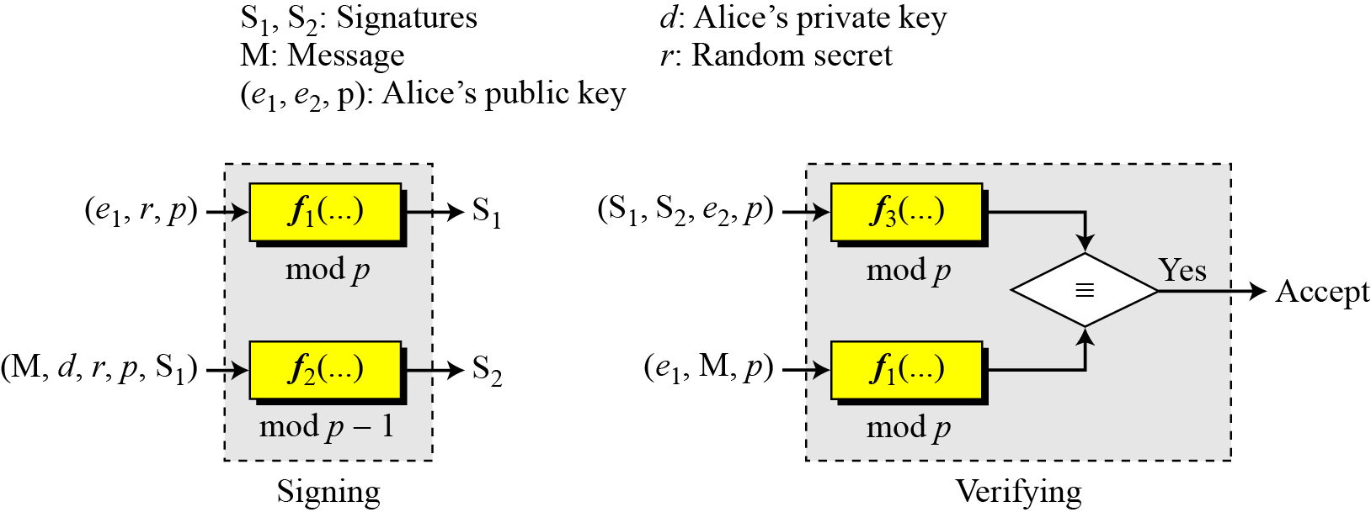
2. ElGamal Digital Signature Scheme
General idea behind the ElGamal digital signature scheme

Slide 26
2. ElGamal Digital Signature Scheme
Key Generation
p is large enough prime number.
Let e1 is primitive root in Zp*
Choose randomly a secret key e₁ with 1 < x < p − 1.
Compute e₂ = e₁ ^{d} mod p.
The public key is (p, e₁, e₂).
The secret key is d, less than p-1.
In ElGamal digital signature scheme, (e₁, e₂, p) is Alice’s public key; d is her private key.

Slide 27
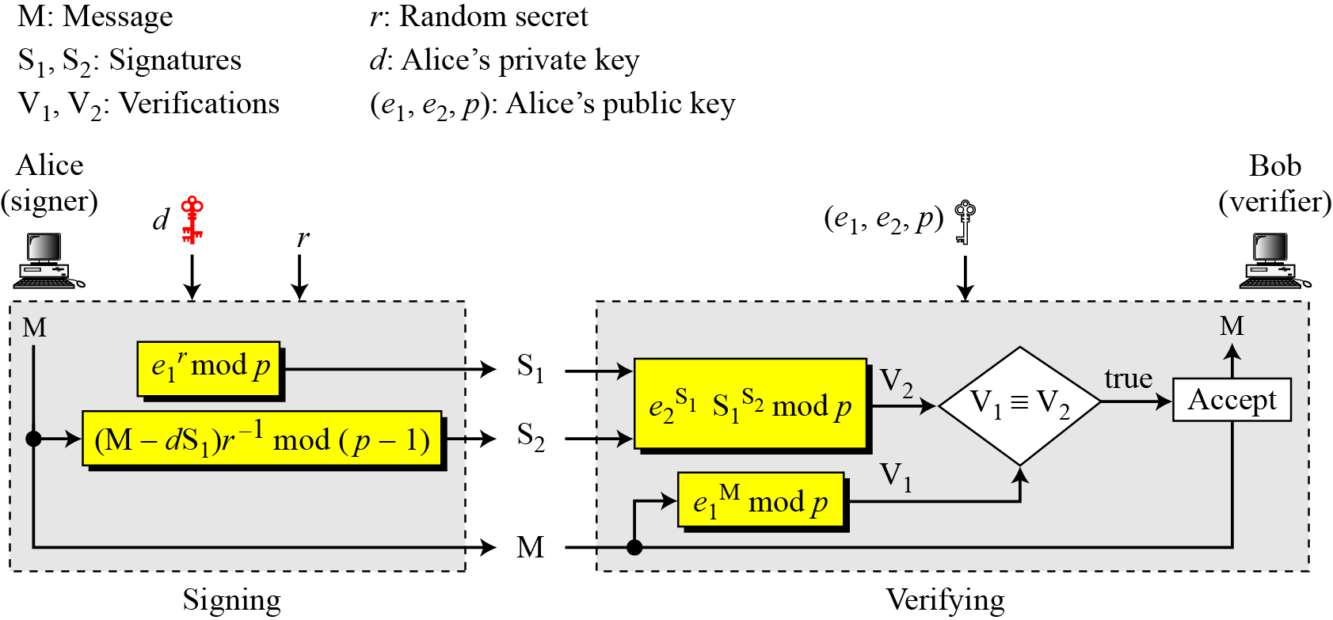
2. ElGamal Digital Signature Scheme
Verifying and Signing
ElGamal digital signature scheme

Slide 28
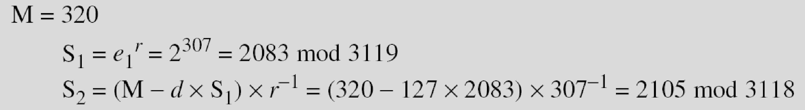
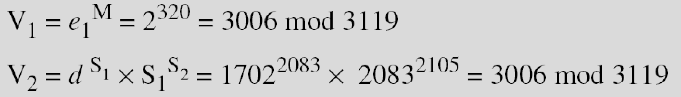
2. ElGamal Digital Signature Scheme
Example
Here is a trivial example. Alice chooses p = 3119, e₁ = 2, d = 127 and calculates e₂ = 2¹²⁷ mod 3119 = 1702. She also chooses r to be 307. She announces e1, e2, and p publicly; she keeps d secret. The following shows how Alice can sign a message.
Alice sends M, S₁, and S₂ to Bob. Bob uses the public key to calculate V₁ and V₂.

Slide 29
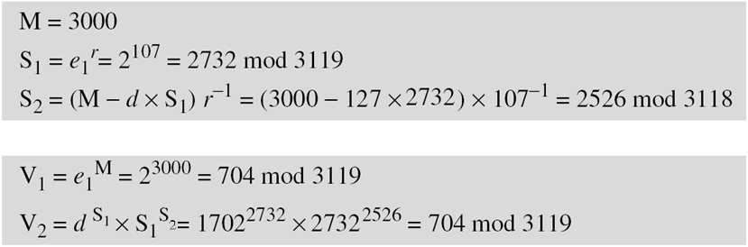
2. ElGamal Digital Signature Scheme
Example
Now imagine that Alice wants to send another message, M = 3000, to Ted. She chooses a new r, 107. Alice sends M, S₁, and S₂ to Ted. Ted uses the public keys to calculate V₁ and V₂.

Slide 30
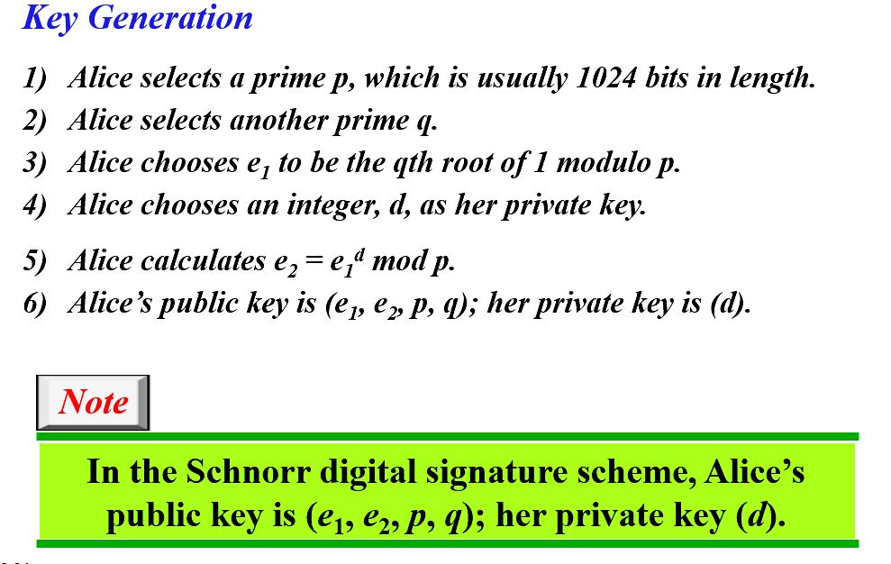
3. Schnorr Digital Signature Scheme
Such that (p-1)=0 mod q
Such that, e1=e₀ ^{(p-1)/q} mod p, e0 is first primitive root of p

Slide 31
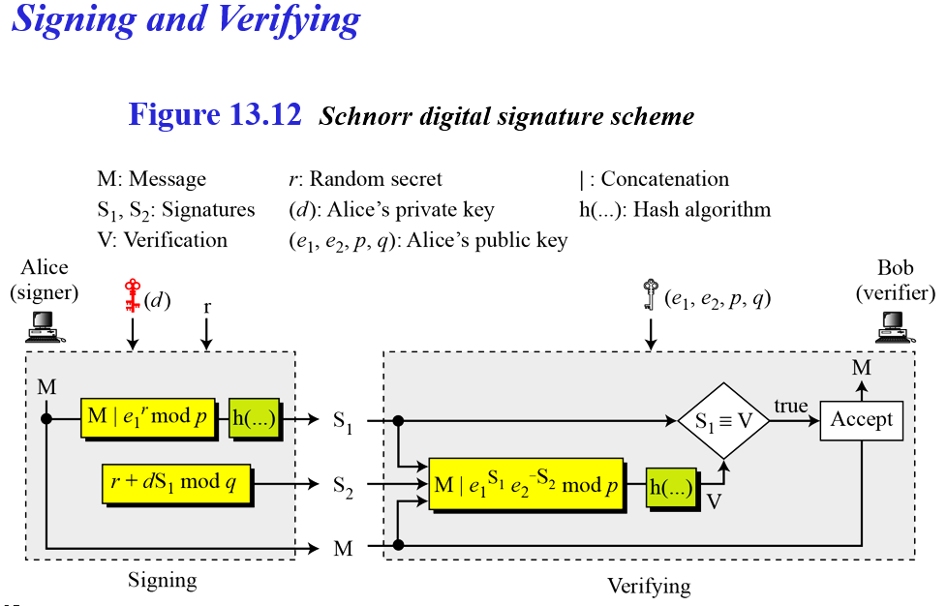
3. Schnorr Digital Signature Scheme

Slide 32
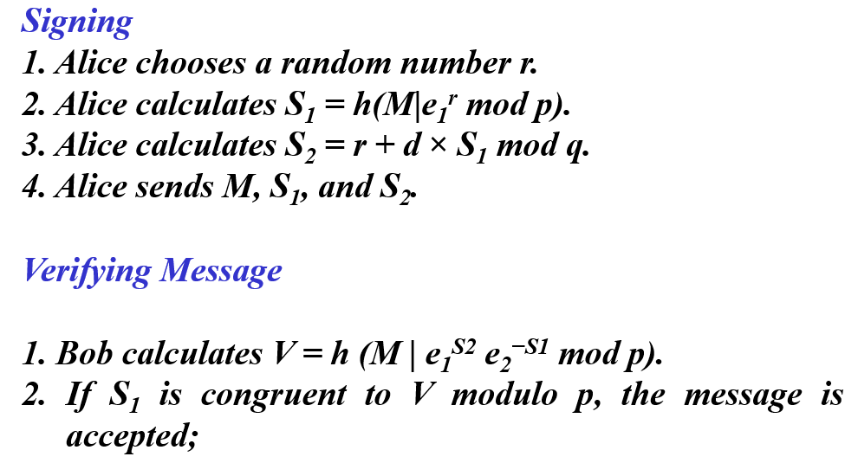
3. Schnorr Digital Signature Scheme

Slide 33
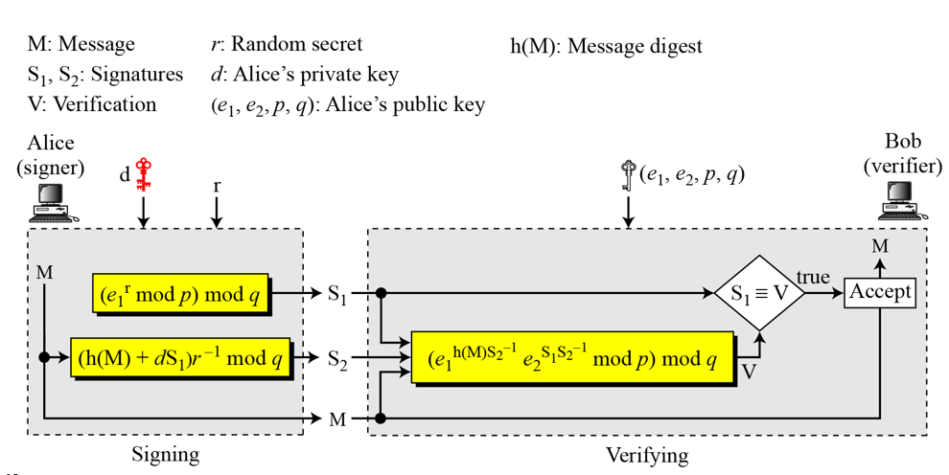
4. Digital Signature Standard

Slide 34
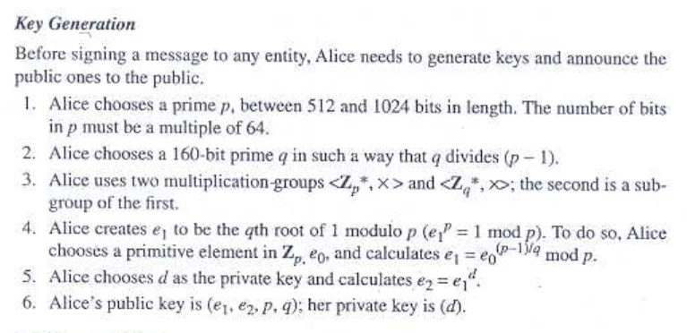
4. Digital Signature Standard

Slide 35
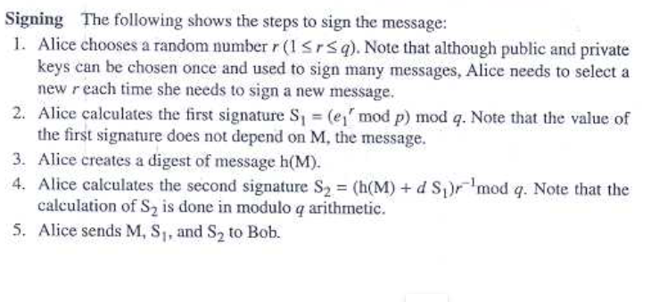
4. Digital Signature Standard

Slide 36
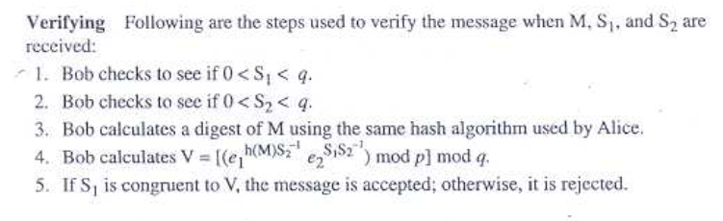
4. Digital Signature Standard

Slide 37
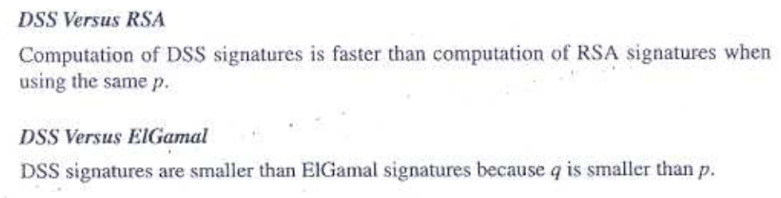
4. Digital Signature Standard

